Slide 1
Development and ways of creation of lines anode oxidation details from aluminium and its alloys
With zero issue of sewage and toxic
Evaporations in a work cycle of processing
Alekseev Andrei

Slide 2
Problem
The analysis of a level of development of existing technologies and the equipment of existing technologies and the equipment anode oxidation details, and also concrete examples of realization of the last as Russian, and foreign manufacturers, shows, that the overwhelming majority of them if not everything, till now do not meet modern requirements, regarding maintenance:
- Highly economic and effective return of used electrolits, solutions and washing water to technological process at all stages processings of details;
- Minimally necessary expenses of time for realization of washing of details;
- Absence of an opportunity temporary plum of used toxic electrolits/solutions or "preservation" of the last on long (the order of 2-10 day) the period of time, without their plum on the centralized clearing constructions (CCC) and without use, or with minimal use of systems of ventilation;
- Qualities of washing of surfaces details of the complex form, etc.

Slide 3
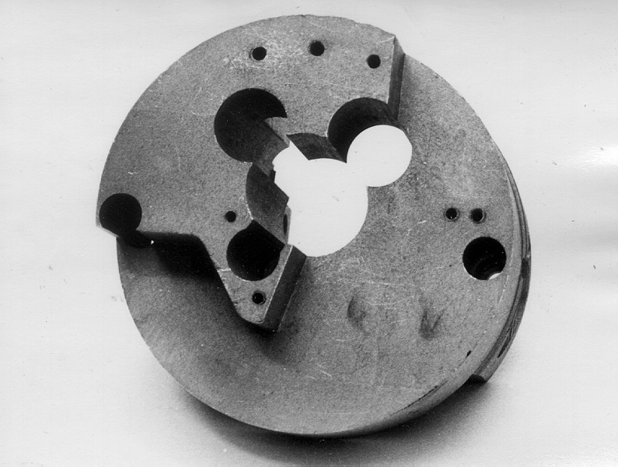
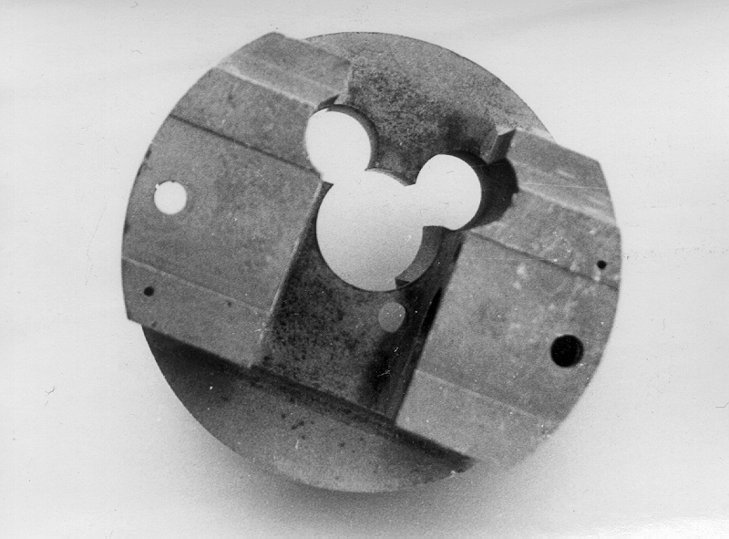
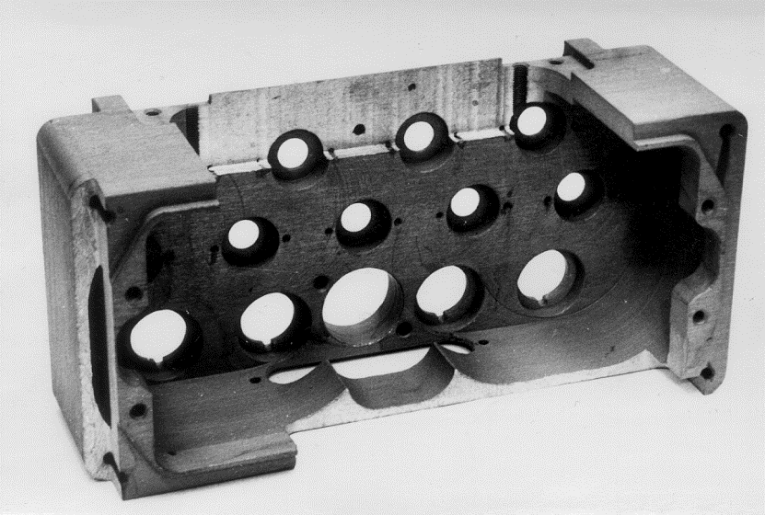
а) б)
Photo 1. A detail of III group of complexity (a material: the alloy is AL - 9)
Photo 2
Photo 2. A detail of III group of complexity (a material: the alloy is D - 16)
To washing such details was applied the manual method of washing with use monojet a nozzle.

Slide 4
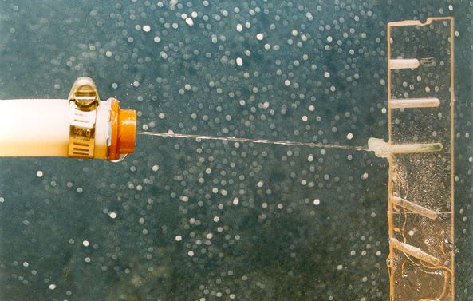
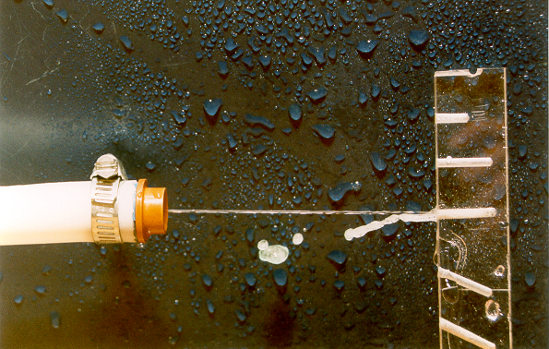
On a photo 3, 4 are presented the stages of physical modelling of the mechanism of clearing of deaf carving apertures.
Photo 3. The initial moment of jet washing of a carving aperture. Photo 4. The final moment of jet washing of a carving aperture.
Objective necessity of the decision of a task on elimination of the subjective factor in conditions of introduction of the automated anodizing lines, has determined a urgency of carrying out of researches on creation of technologies and the equipment for washing details of the complex form during their moving concerning jets of a washing liquid.

Slide 5
The decision
1. Universal methods of realization of the equipment for anodizing details with zero issue of sewage.
On V.F.Henli's recognition, chairman of committee on anodizing the British institute of standards, common fault of installations of anodizing is incomplete and inefficient washing between two adjacent stages of process that conducts to excessive pollution of electrolits and deterioration of processing.
In this connection significant interest can represent, developed by the author, universal methods of realization of the galvanic equipment and interoperational clearing of surfaces of the details, structures using respective alteration and configurations of a galvanic line, and also spatially-functional change the basic operations classical - the combined method of washing.
They provide:
1. Realization of any galvanic line in the form of set of corresponding operational modules (degreasing, etching, anode oxidation, colouring and others) with the system of removal of toxic evaporations.
2. Realization of each of operational modules (OM) in two-level-or three-level (including a tank for emergency plum of a corresponding kind of sewage and/or the processing environment) configuration (Look a photo 5).

Slide 6
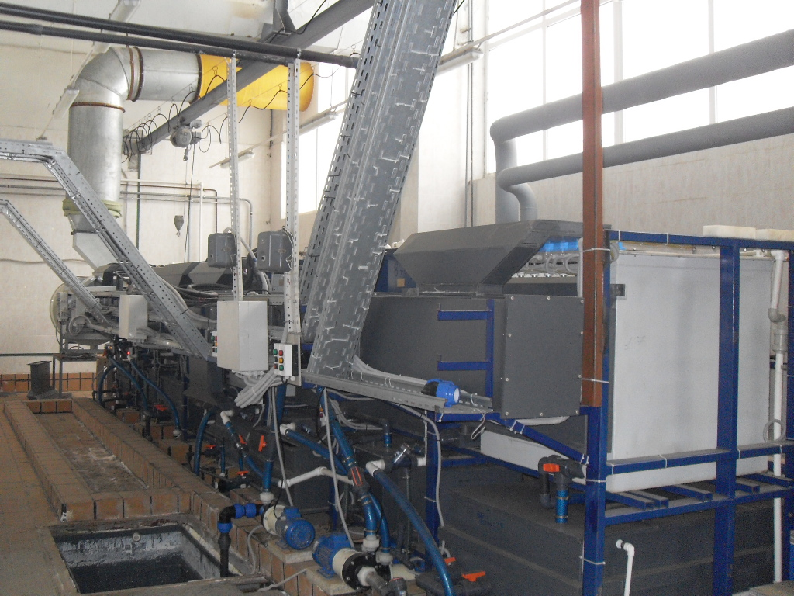
Photo 5

Slide 7
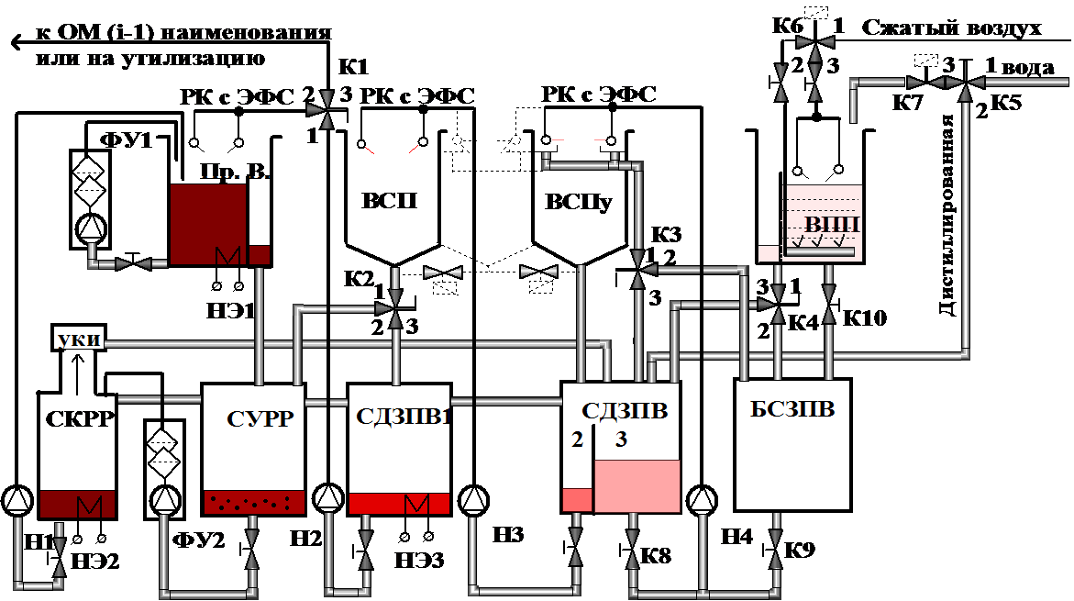
3. Realization of any system of interoperational clearing of surfaces of details in the form of consistently carried out operations of multistage jet-dynamic washing sold in a counterflow mode, and operation of washing of details by a method of immersing, presented in figure 1.
Fig. 1.OM contains a system of distributed multi - step jet counterflow rinsing and:
Пр. В – electroplating tank; ВСП, ВСПу – jet rinsing tank; ВПП - immersible rinsing tank; СКРР – tank– сoncentrator of the electrolyte;
сурр - tank–catcher of the electrolyte; сдзпв 1,2,3 – tank for dirty rinsing water; БСЗПВ - tank for merger dirty rinsing water;
УКИ–equipment for condensation of the evaporations; РК с ЭФС– tube with jet forming elements (JFE); ФУ - equipment for filtration of the electrolyte; Н1-Н4 – electropumps

Slide 8
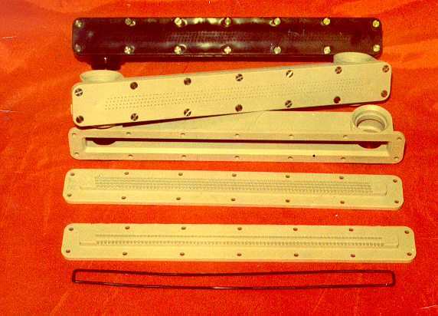
4. Use, as elements of formation of jet streams, jet forming panels with nozzle conoid orifices, providing formation multi-line «packets» of thin (Ø ≈ 0, 7 mm) jets of the maximum kinetic energy washing liquid at use sources of low pressure (Р = 0,15-0,3 МРа), presented in photo 6.
Photo 6. JET FORMING ELEMENTS (JFE) OF THE WASHING LIQUIDS WITH MODULE DIAL-UP PANELS (MDP) FROM POLIPROPILEN, PRODUCED ON PATENT 2046685 RF (AUTHOR - ALEKSEEV A.N.)

Slide 9
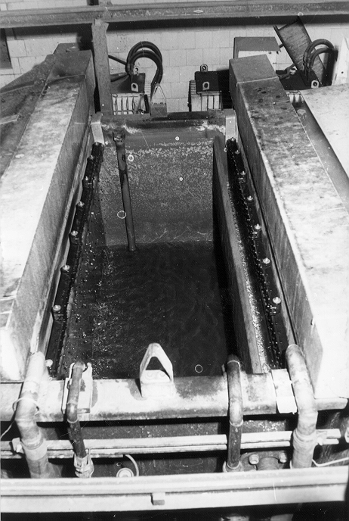
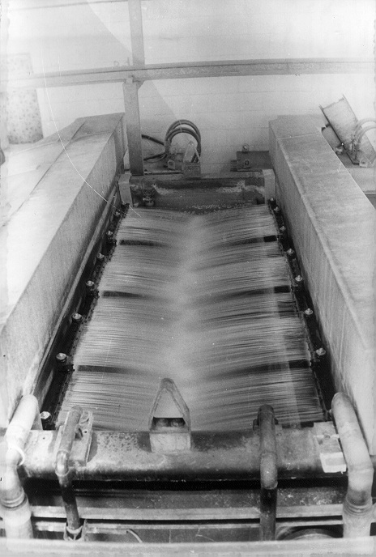
On photo 7 is presented bath of washing in structure of an automatic galvanic line for anode oxidation details placed on suspension brackets «DYNA-PLUS-160» firms " Shering " (now - «Atotech»), equipped by a contour jet-dynamic washings (kind a). A kind б-during submission of washing water in JFE.
Photo 7
а) б)
At productivity of 2 racks at hour, volume of sewage has made: 0,2 × 14 × 7 = 19, 6 litres × 2 = 39, 2 litres.
On old technology, at use direct-flow washings, using a method of immersible rinsing, for baths with dimensions (length× width×height) - 1600мм×700мм×1200мм, the hour volume of sewage makes ≈ 1000 litres. Thus, is noted absence of presence of electrolit from deaf apertures on details II and III groups of complexity in the form of the dark, brown spots formed on surfaces of details after their drying.

Slide 10
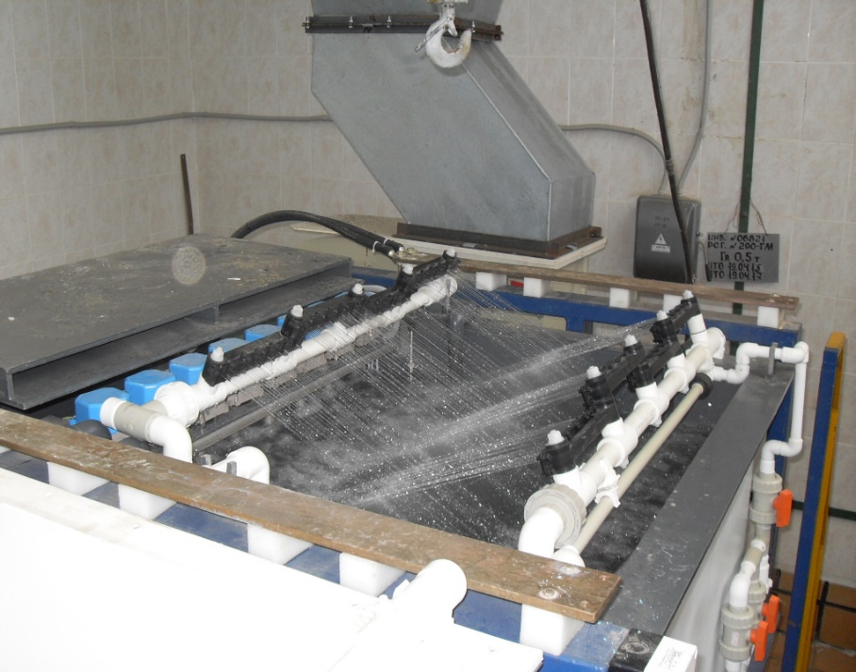
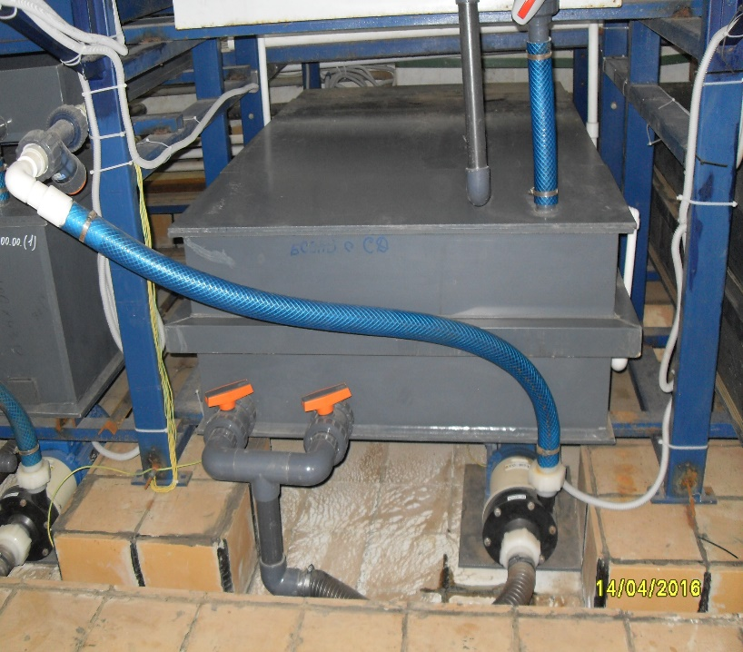
5. Accommodation:
- on top level an OM, located in technological sequence a process bath, a bath (baths) of jet-dynamic washing, and also a bath of immersible washing or the combined way, and first of steps of washing is carried out by a jet method (in particular, for process baths with heating the processing environment, at processing details on racks) - look photo 8;
- at the bottom level the OM, in return to a course of technological process the sequences equipped by local pressure head systems (including with filtering elements) and/or onboard suction ducts: a tank-store of the polluted washing water (Look photo 9), tanks of the pure and polluted washing water, the tanks-catcher of a solution of a process bath or a tank with the cooled electrolyte of a process bath, the collection-concentrator of the diluted electrolyte of a process bath, etc.
Photo 8. The process bath equipped by a contour of jet-dynamic washing and a contour for removal of evaporations formed in a bath in her exhaust cap
Photo 9. Tank for plum of the polluted washing water .
and the collection of pure washing water

Slide 11
Dependence of time of a work cycle of washing goods from number (N^{St.}) and a kind of steps of washing
Two-level direct-flow washing by immersing in separate baths (in accordance with GOST 9.314-90).
Three-stage counterflow washing by immersing (in accordance with GOST 9.314-90).
Three-stage jet counterflow washing from bathing washing by immersing in the scheme the OHM on fig. 1*.
4. Two-level jet counterflow washing from bathing washing by immersing in the scheme the OHM on fig. 1*.
* - at maintenance of quality of washing of details II and III groups of complexity.
Fig. 2

Slide 12
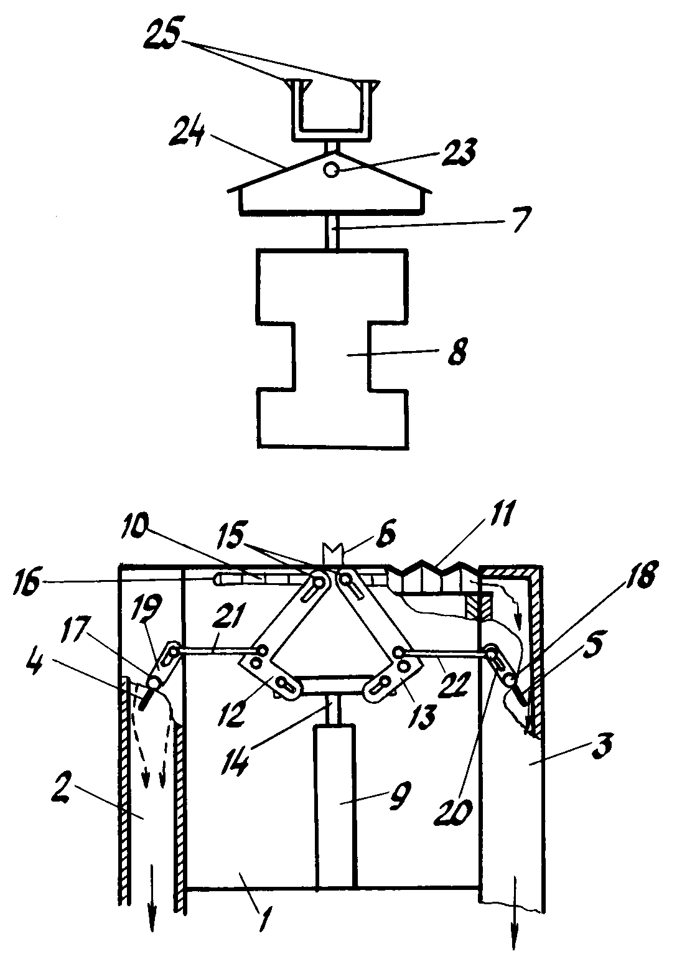
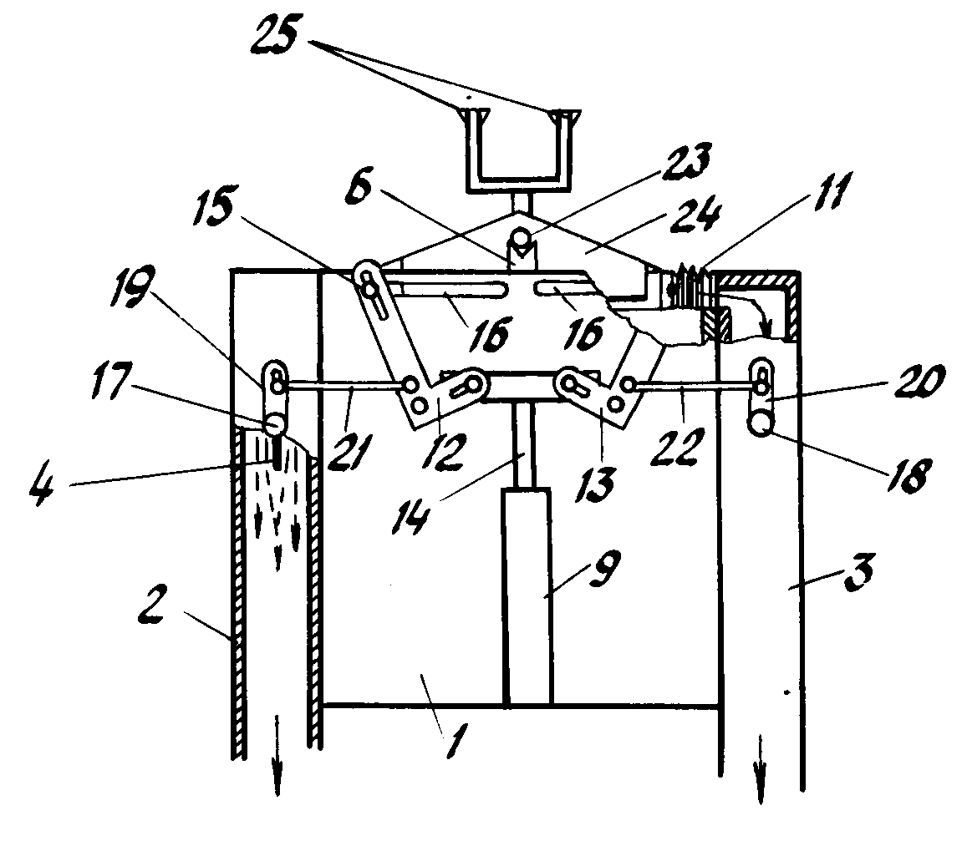
2. Universal methods of realization of the equipment for anodizing details with zero issue of toxic evaporations.
2.1 Processes of partial shielding of a surface of a mirror of a bath are offered to be carried out in vertical concerning a surface of its mirror of a plane.
Fig. 3, а
Fig. 3, б
Рис. 3. 1 – process bath; 2, 3 – fume extraction; 4, 5 - rotary plates; 6 - support for accommodation of a bar; 7 - rack; 8 -goods;
9 - pneumocylinders; a cover in the form of accordions 10, 11; 12, 13 - drafts; 14 - rods of pneumocylinders 9; 15 - axes; 16 - grooves; 17,18 - axes rotary regulators 4, 5;19, 20 - levers; 21, 22 - directing; 23 - a bar ; 24 - the device for shelter of a bath with Δ- th form; 25 - transport arms.

Slide 13
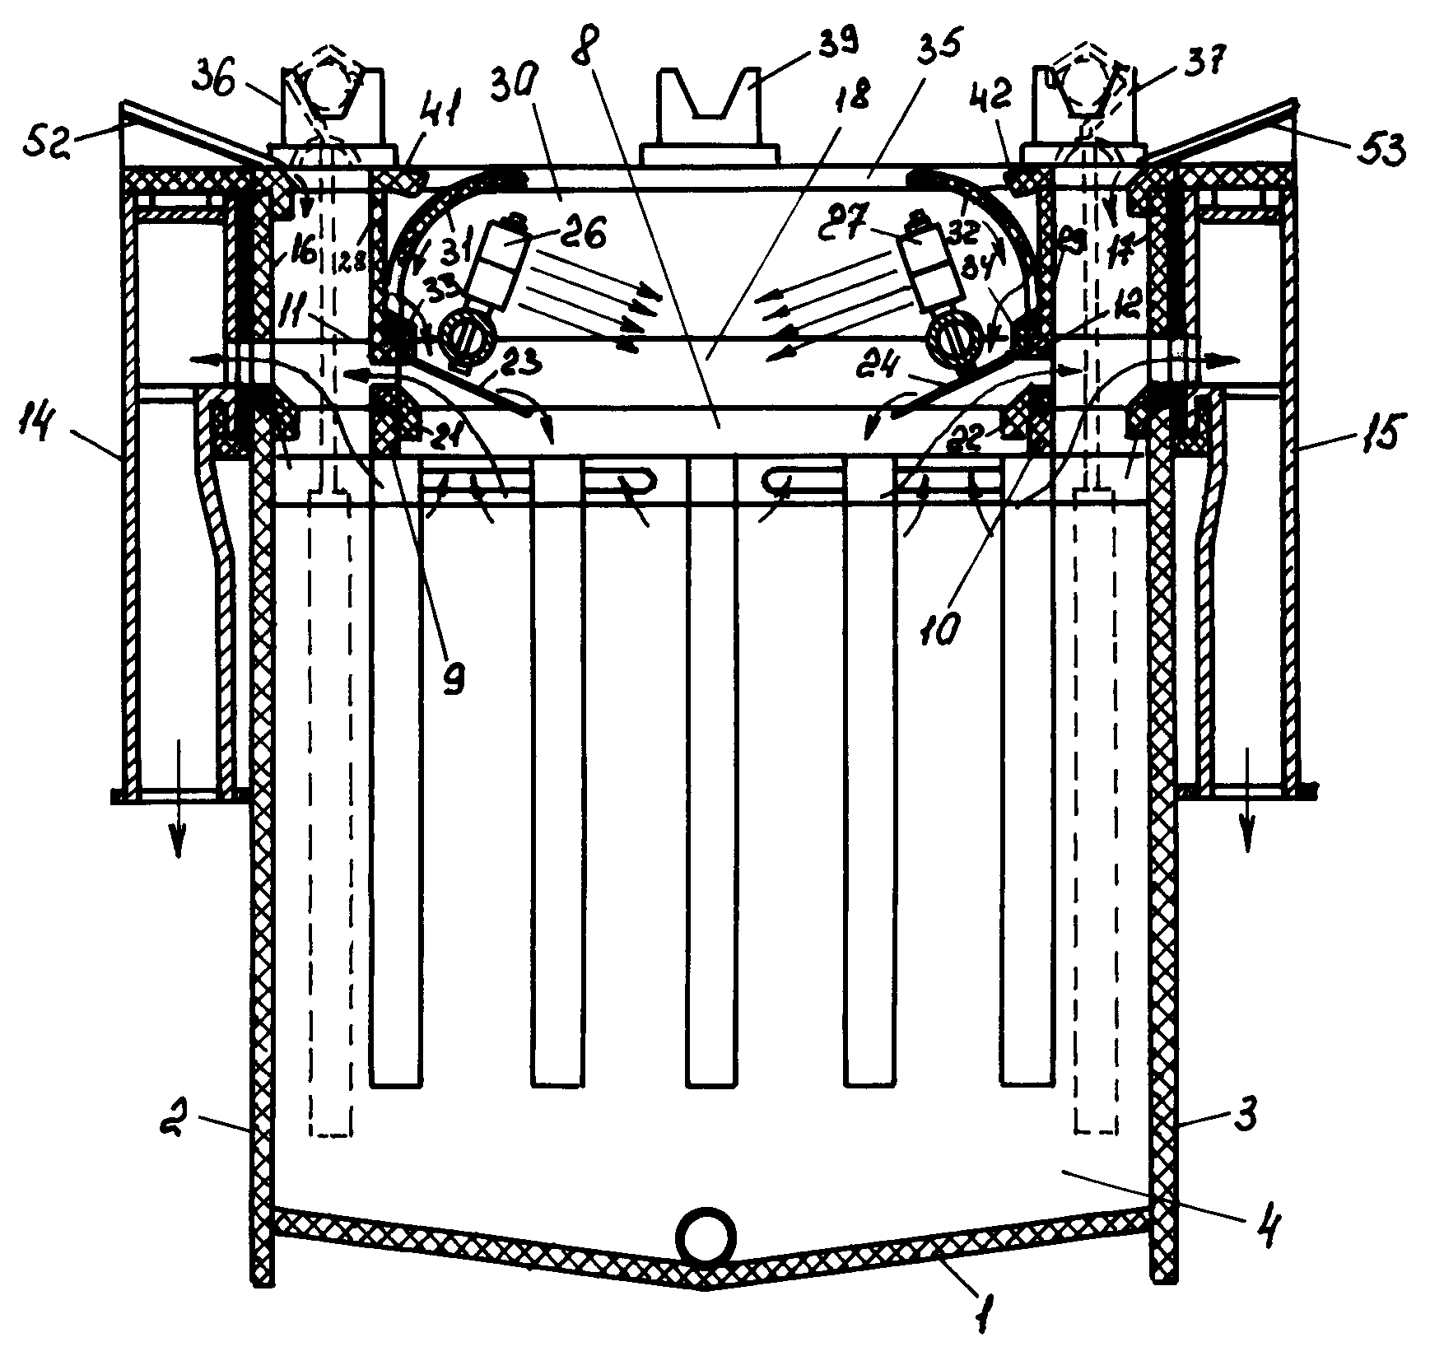
2.1 Realization of removal of toxic evaporations and during transportation of details, equipment the autooperator (AO) a cap for catching harmful toxic evaporations the process baths, connected to system of exhaust ventilation
THE LINE FOR GALVANOCHEMICAL TREATMENT OF DETAILS (fragment)
Part of line (operational modul) of galvanic - chemical treatment with effective recovery of vapours, corrosive gases, aerosols and new construction all tipes tanks (Patent of Russia № 2080425).
Fig. 4. Operational modul (OM) of galvanochemical treatment (fragment) with low power consuming and the most efficient recuperation of valuable chemical components and rinse water in technological process, at minimum energy consumption, time and working areas.

Slide 14
3. The conclusion
Use of offered technologies and the equipment, despite of much (in 1,5 - 2 times) greater, in comparison with expenses for creation of traditional galvanic lines, allows to provide:
- absence (in a work cycle of processing) sewage and toxic evaporations, at the minimal expenses of time, working areas, power resources and chemicals for the majority of known technological processes (degreasing, etching, anode oxidation, colouring, etc.). Thus, the work cycle of processing is understood as time before failure of electrolit/solution of a corresponding process bath of a line anode anodizing;
- absence of necessity of construction or significant (in tens times) reduction in capacity of the centralized clearing constructions;
- the most economic return (up to 95-99 %) valuable chemical components of electrolits and solutions directly in process baths, including a stage of transportation;
- improvement of quality of washing of details, in particular, containing deaf persons, including carving apertures of small diameter, narrow grooves and undercuts;
- an opportunity time plum of used electrolytes and solutions or "preservation" of the last on long (the order of 2-10 day) the period of time, without their plum on the centralized clearing constructions (CCС) and without use, or with minimal use, systems of ventilation, etc.
And the time of recovery of outlay of such equipment can make 2-3 years.
Experimental check and/or commercial operation of offered technologies and the equipment (during with 2002 for 2016) at the various enterprises/firms has confirmed achievement of the above-stated parameters.

